Slide 1


THE
FACULTY OF
ENGINEERING
X THE PLACE OF USEFUL LEARNING
www.strath.ac.uk/engineering

Slide 2
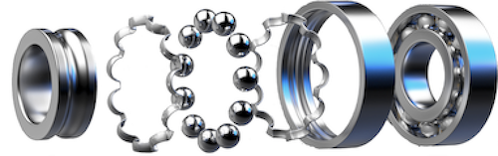
DIGITAL TWINNING THROUGH PHYSICS INFORMED MACHINE LEARNING. A VIBRATING BEARING CASE STUDY Zara Weir

Slide 3
CONTENTS
Intro to PIML
Plan for summer internship
Literature review and state of the art
Methodology and results
Future work
Other activities

Slide 4
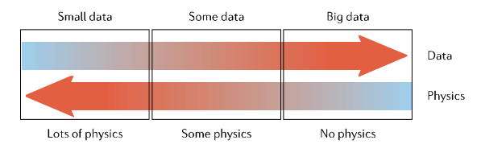
INTRODUCTION TO PHYSICS INFORMED MACHINE LEARNING
Observational bias – data that embodies underlying physics
Inductive bias – incorporating mathematical constraints
Learning bias – train the model so that it favours physically sound models
Karniadakis, George Em, et al. "Physics-informed machine learning." Nature Reviews Physics 3.6 (2021): 422-440.

Slide 5
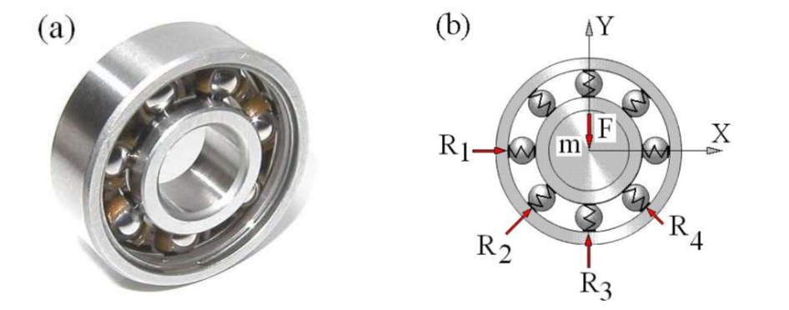


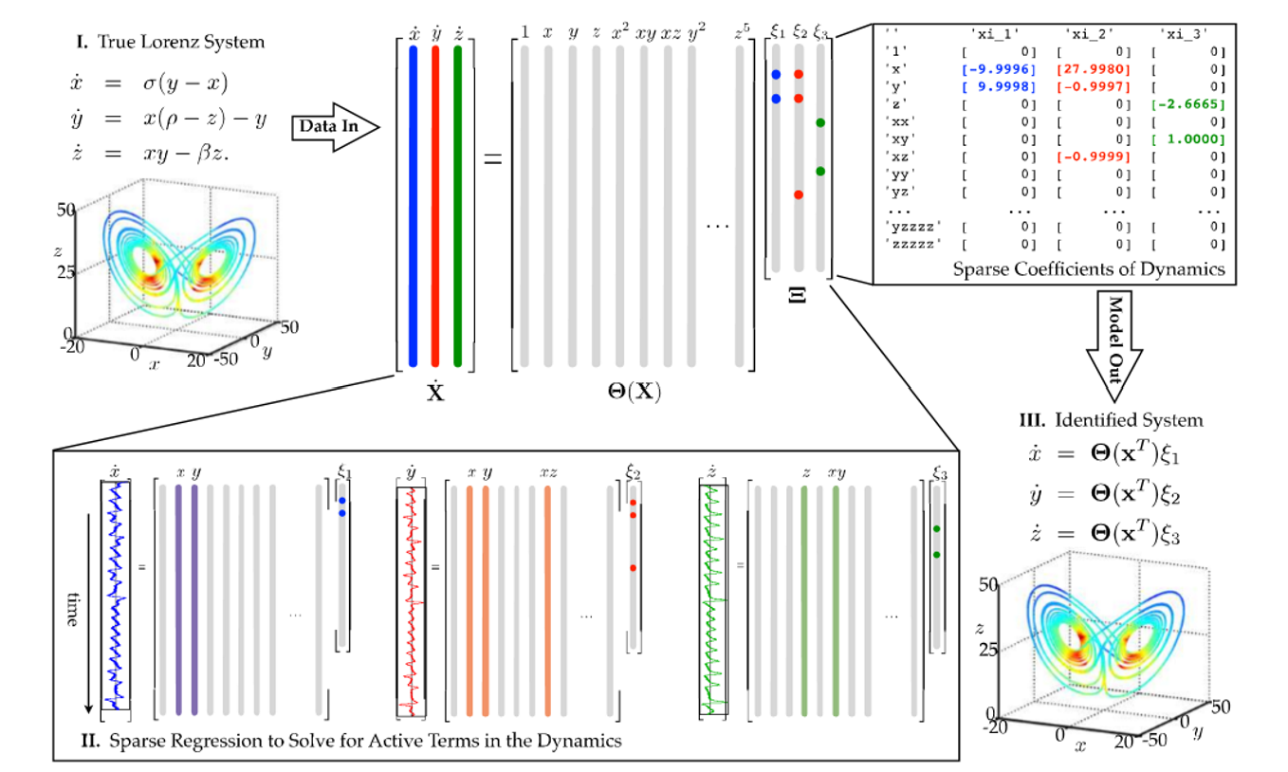
PLAN FOR MY SUMMER INTERNSHIP
Goals
Support a cross-faculty team investigating digital twins
Support a case-study demonstration utilising a PIML approach intended to provide insight into asset behaviour/health for PHM (Prognostic and Health Management)
Activities
Activity 1: Physics model of rotating bearing vibration
Activity 2: Apply pre-determined Machine Learning (ML) algorithm, SINDy to related condition monitoring dataset to recover underlying dynamics
Activity 3: Using the ML modelling insights to augment the physics model
Activity 4: Use the PIML model to predict asset behaviour/health
SINDy
Prediction

Slide 6
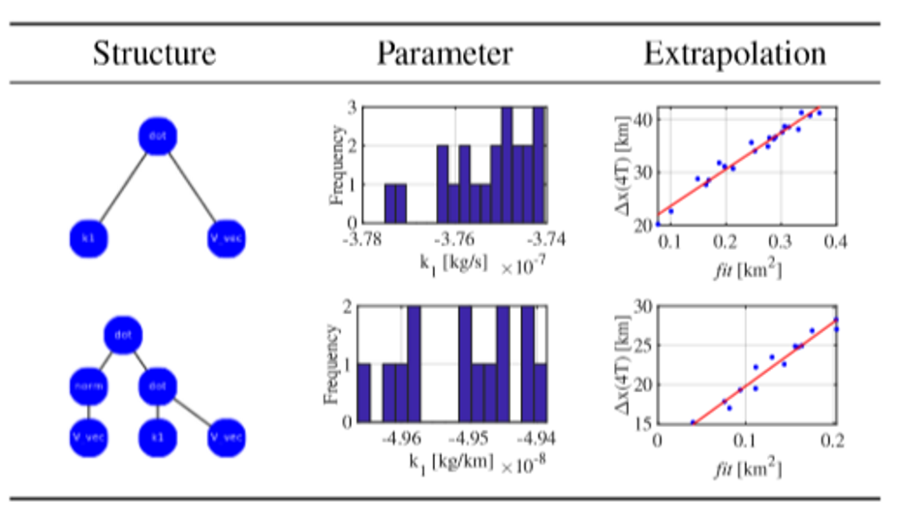
LITERATURE REVIEW AND STATE OF THE ART
Brunton, Steven L., Joshua L. Proctor, and J. Nathan Kutz. "Discovering governing equations from data by sparse identification of nonlinear dynamical systems." Proceedings of the national academy of sciences 113.15 (2016): 3932-3937.
Kostek, Robert. "Simulation and analysis of vibration of rolling bearing." Key Engineering Materials. Vol. 588. Trans Tech Publications Ltd, 2014.
Manzi, Matteo, and Massimiliano Vasile. "Discovering unmodeled components in astrodynamics with symbolic regression." 2020 IEEE Congress on Evolutionary Computation (CEC). IEEE, 2020.

Slide 7
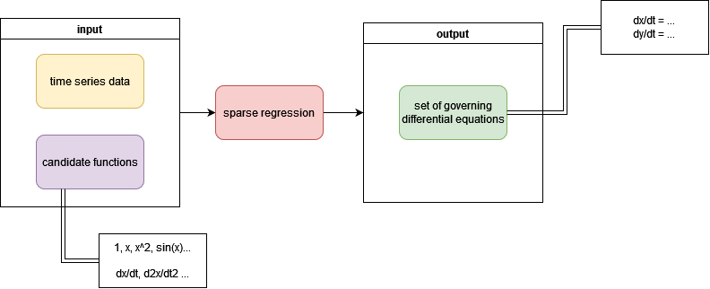
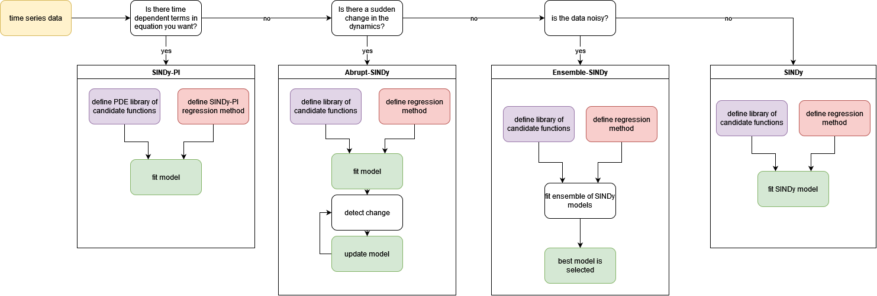
METHODOLOGY 1/3

Slide 8
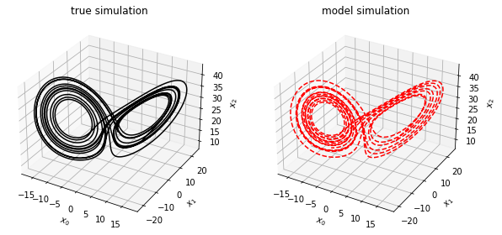
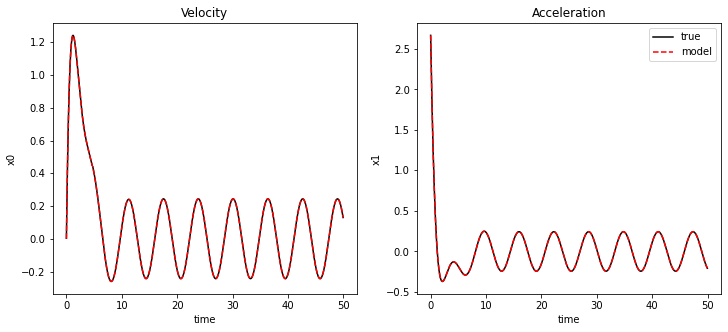


METHODOLOGY 2/3
Chaotic Lorenz System
SINDy
Spring-Damper-sin
SINDy-PI
$$\dot{x}=10\left(y−x\right),$$
$$\dot{y}=x\left(28−z\right)−y,$$
$$\dot{z}=xy−\frac{8}{3}z$$
(x0)' = -9.999 x0 + 9.999 x1
(x1)' = 27.992 x0 + -0.999 x1
+ -1.000 x0 x2
(x2)' = -2.666 x2 + 1.000 x0 x1
$${\dot{x}}_{0}=x_{1}$$
$${\dot{x}}_{1}=\frac{10}{3}−\frac{4}{3}x_{1}−\frac{2}{3}x_{O}−\frac{1}{3}sin\left(t\right)$$
x0_t = 0.9997 x1 + -0.0002 x1_t
x1_t = 3.3318 1 + -0.6664 x0 + -0.4933 x1 + -0.1665 sin(t) + -0.1665 sin(t) + -0.8392 x0_t

Slide 9
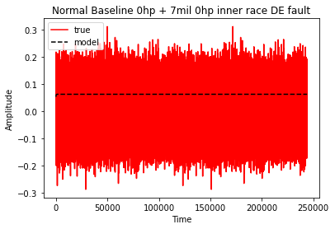
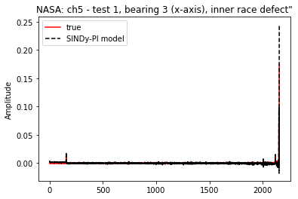
METHODOLOGY 3/3
Case Western Dataset
NASA Bearing Dataset
SINDy Model
(x0)' = 0.005 x0 + -0.061 x0^2 + -0.292 x0^3 + 0.386 x0^4 + 3.731 x0^5
SINDy-PI Model
x0_t = 0.0025 1 + 0.0001 sin(t) + 0.1869 x0_tt + 0.0025 1 + -0.0702 x0 + 0.0773 x0^2 + 1.2988 x0^3

Slide 10
FUTURE WORK
More complex industrial data
Predicting
Continuing literature review

Slide 11
OTHER ACTIVITIES
Python, MATLAB
Reading academic papers
Seminars
Technical writing
RIAS programme

Slide 12
X THE PLACE OF USEFUL LEARNING

